Slide 1
Enigma Cipher
By: Prashaant Mudgala
Mentor: Nolan Ashvin Miranda

Slide 2
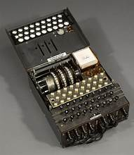
The History
The Enigma cipher was developed in the 20th century and highly used during WWII.
The Cipher was one of the most powerful at the time and the only way to decipher a text encrypted by the cipher was to obtain the key.
The machine was put into use by various militaries such as Nazi Germany because none of the other countries could break the code.

Slide 3
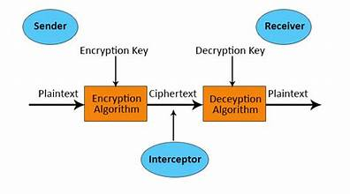
Cryptography
Cryptography is the art of hiding information.
Encryption is the processes of converting plain text into unintelligible text.
Decryption is using a key to convert ciphertext back to plain text.
The Key used can be symmetric or asymmetric.

Slide 4
How Does Encryption Work?
A simple example of encryption is where the 26 alphabets are wired with a different alphabet pair.
Input: “hello”
Encrypted output: “oxneh”
The output will make no sense to you unless you have the key to decipher it.
A
B
C
D
E
F
G
Y
G
A
Q
X
P
L

Slide 5
Enigma Cipher Stages
The plugboard can have up to 13 pairs of alphabets. If the letter pressed has a pair, it is swapped with it.
There are 3 rotors in the Enigma machine that encrypt the letter passing through them
The reflector acts as another plugboard which sends the message back through the rotors and plugboard
Keyboard
Plugboard
Rotors
Reflector
Message
The encrypted letter lights up on a lightboard which is copied down.
Lightboard

Slide 6
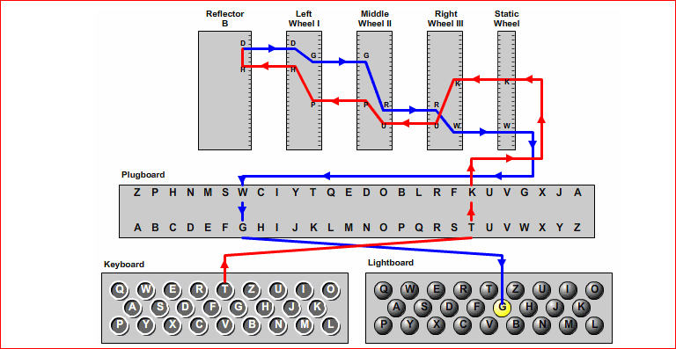
Overview Enigma Machine Parts

Slide 7
First Component: The Keyboard
The first component of the Enigma Machine is the keyboard.
It takes in user input to be ciphered.

Slide 8
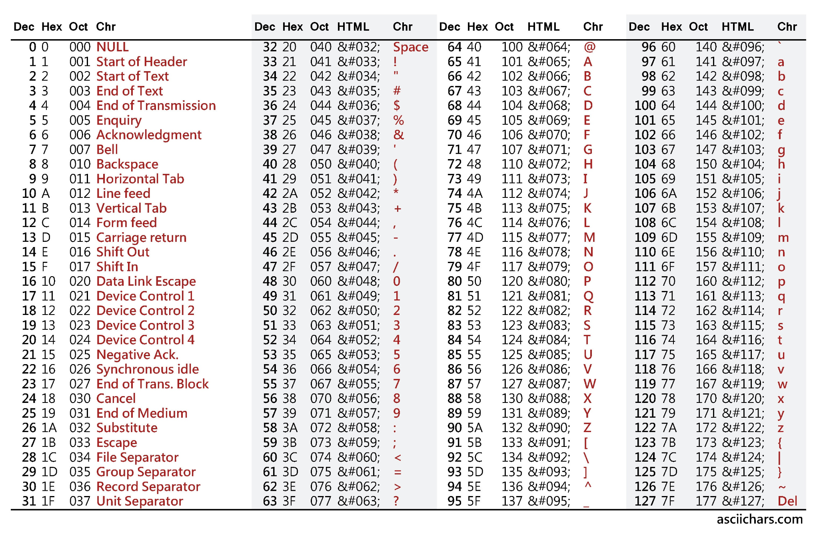
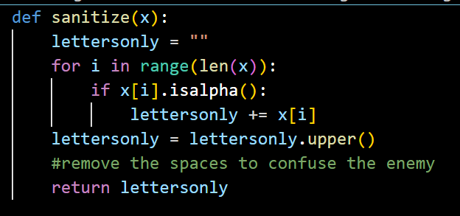
The “sanitize” Function
It removes all spaces and capitalizes the entire message
No spaces strengthens the ciphered text
Capital letters simplify coding the routers with the use of the ASCII chart.

Slide 9
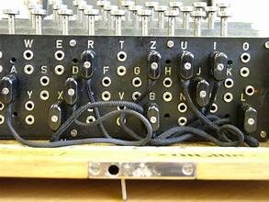
Second Component: The Plugboard
The plugboard has to be used manually to swap letters with an inserted plug.
This is where the first cipher happens.

Slide 10
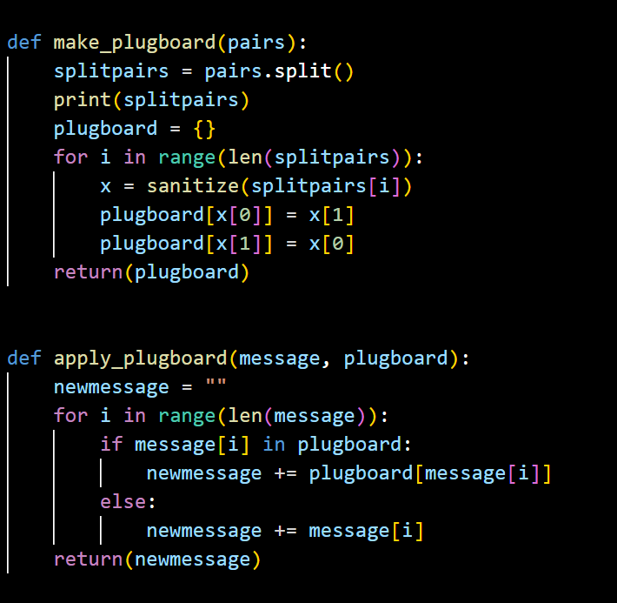
My Plugboard Settings
If no plugs are inserted is the plugboard, the letters go directly into the rotors.
Creating 10 plugboard pairs was a conventional number when using the enigma machine, although 13 pairs are the maximum possibility.
I created a string variable to store all my pairs and used the “.split” method to break them apart in my function.
My pairs:
b & q | m & t
c & r | o & s
d & i | p & x
e & j | u & z
k & w | g & h

Slide 11
Third Component: The Static Wheel
The static wheel contains all of the alphabet.
It receives the letters from the plugboard to be ciphered and sends them back out of the plugboard once ciphered.
It is the starting wheel.

Slide 12
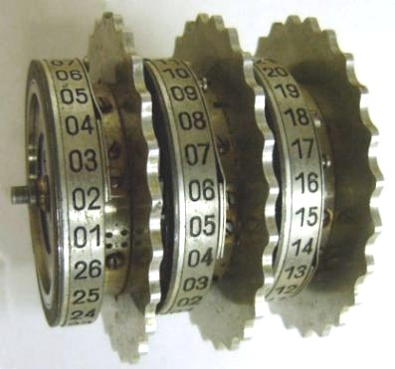
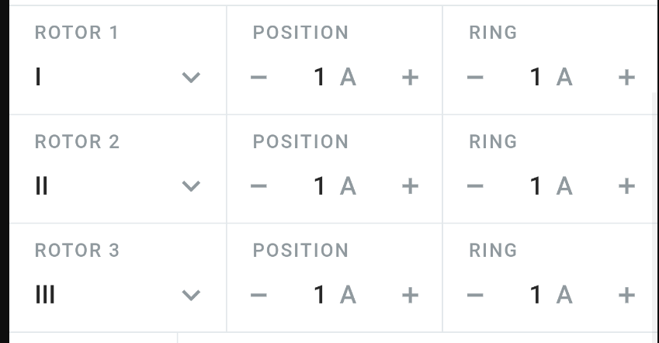
Fourth Component: Rotors
Rotors
The rotors are labeled 1-26:
1 corresponds to A
2 corresponds to B
…
26 corresponds to Z
Rotor 1:
Rotates after ~26 turns of Rotor 2.
Rotor 2:
Rotates after ~26 turns of Rotor 3.
Rotor 3: Rotates every time a key is pressed on the keyboard.
* The two notches on rotor 1 & 2 are on letters “W” and “F”

Slide 13
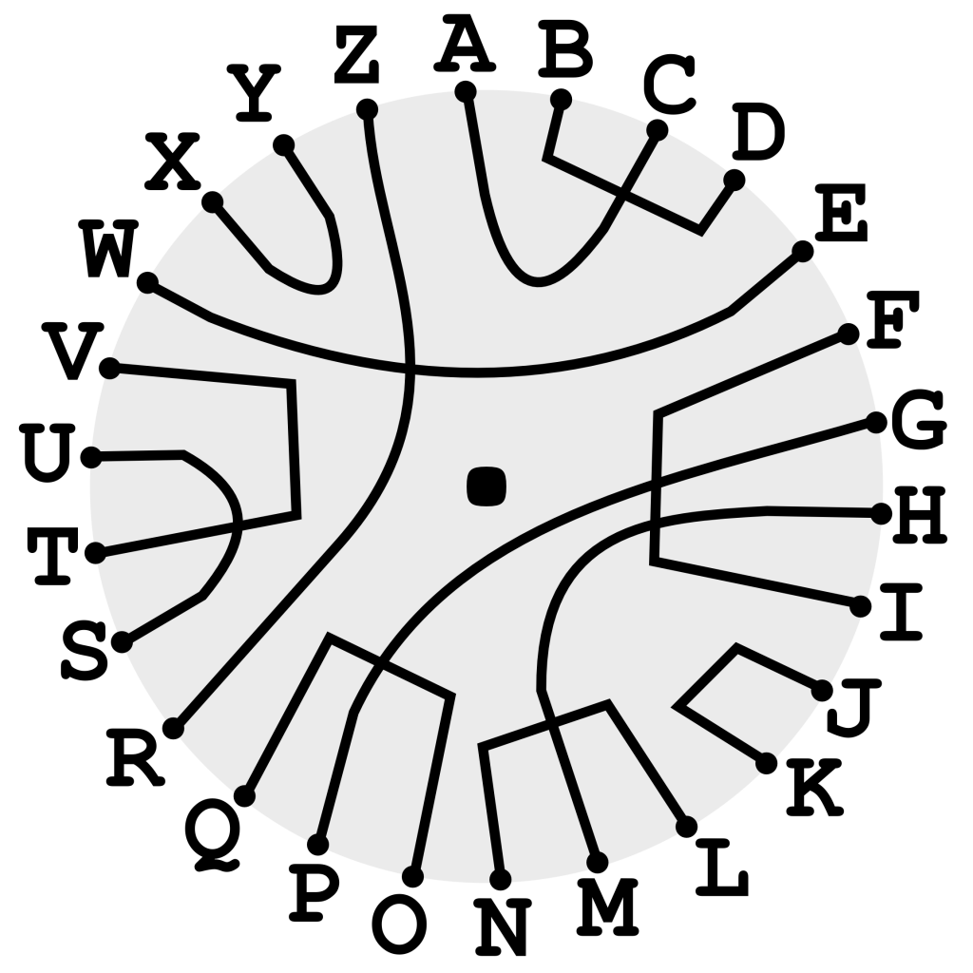
Fifth Component: The Reflector
The reflector is where half of the alphabet is wired to the other half allowing for one swap of the letters before they re-enter the rotors.

Slide 14
Sixth Component: The Lightboard
The light board lights up the resulting letter after the cipher is completed.
This letter is the output of the cipher.

Slide 15
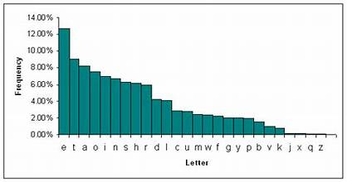
Why is the Enigma Cipher so unique?
Each letter is always paired up with a different corresponding letter.
The spinning rotors make it to that the letters are swapped randomly every time so there are no weaknesses in the cipher.
For example: there is never a most repeated letter to try and decipher the code with.

Slide 16
Code Implementation

Slide 17
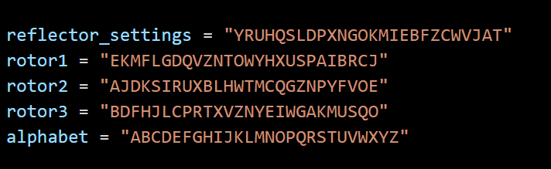
Implemented Model Details
Model name: Enigma I
Reflector UKW B
The settings used for this model and reflector were assigned to the following variables in the code

Slide 18
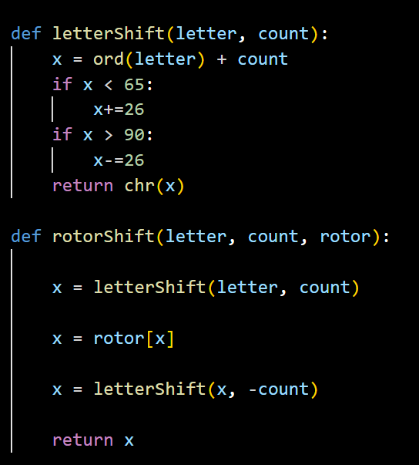
Rotor Shift Function
ASCII values for the capitalized alphabet allowed me to use Python’s “ord()” and “chr()” built in functions for conversions and shifts.

Slide 19
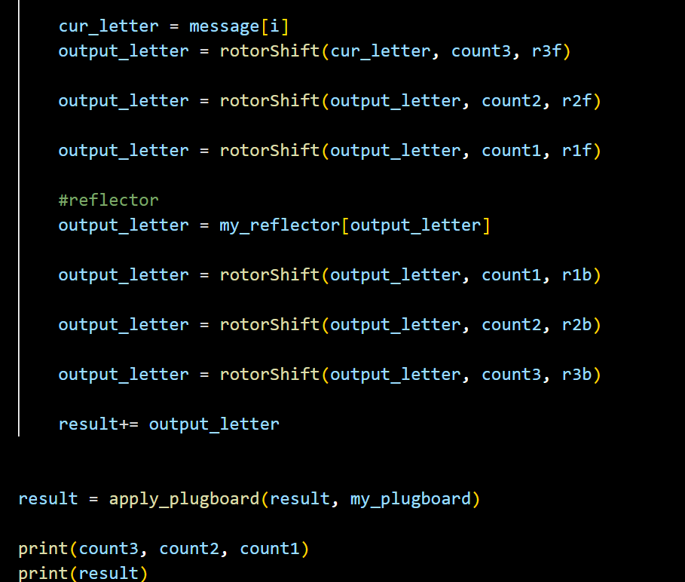
Encryption Process
The last step in the code was to put the functions into action.
The user input goes through the rotors from rotor 3 → rotor 1, followed by an encryption by the reflector and then back from rotor 1 → rotor 3.
The result goes through the plugboard once again.
Finally the output is printed.

Slide 20

DEMO VIDEO

Slide 21

Thank You

